Slide 1


Critical Contingency Management
General Overview
22 April 2026

Slide 2
Intro:
Julie Langford; Graham Alexander; Rene D’Ath - 3 “approved” CCO’s who share the role.
Session Objective – High level overview/refresher to get industry participants thinking about their roles and responsibilities.
CCM Regulations are very detailed, and more information is available.
Feel free to ask questions as we go. I can respond to Chat queries at the end of the session

Slide 3
Critical Contingencies
What are they?
Who is required to act?
What are they required to do?
How do we prepare?
How are they fixed?
Where do you get more information?
Why do we have Regulations?
When do they occur?

Slide 4

What are Critical Contingencies?

Slide 5

A Critical Contingency is:
a shortage of gas relative to demand that can’t be resolved through standard industry processes
typically associated with production or transmission system failure
Gas consumers can’t be automatically switched off to reduce demand (unlike electricity)
It’s expensive and time consuming to reinstate a gas network if the pressure drops too low.

Slide 6
Why have regulations for Critical Contingencies?

Slide 7
The Regulations assign clear responsibilities and stipulate a process with associated timeframes to ensure a co-ordinated industry response.
2008
Gas Governance (Critical Contingency Management) Regulations 2008 introduced
2011
Major Critical Contingency on the Maui pipeline 2011
2014
Regulations were amended in 2014
2024
Regulations amended to remove Taupo and Broadlands DP Pressure Thresholds

Slide 8
When do Critical Contingencies occur?

Slide 9
When Transmission system pressure drops, or is expected to drop, below a threshold
Gas production has an unplanned outage
A physical problem with the gas transmission pipeline system
Supply can't keep up with demand

Slide 10
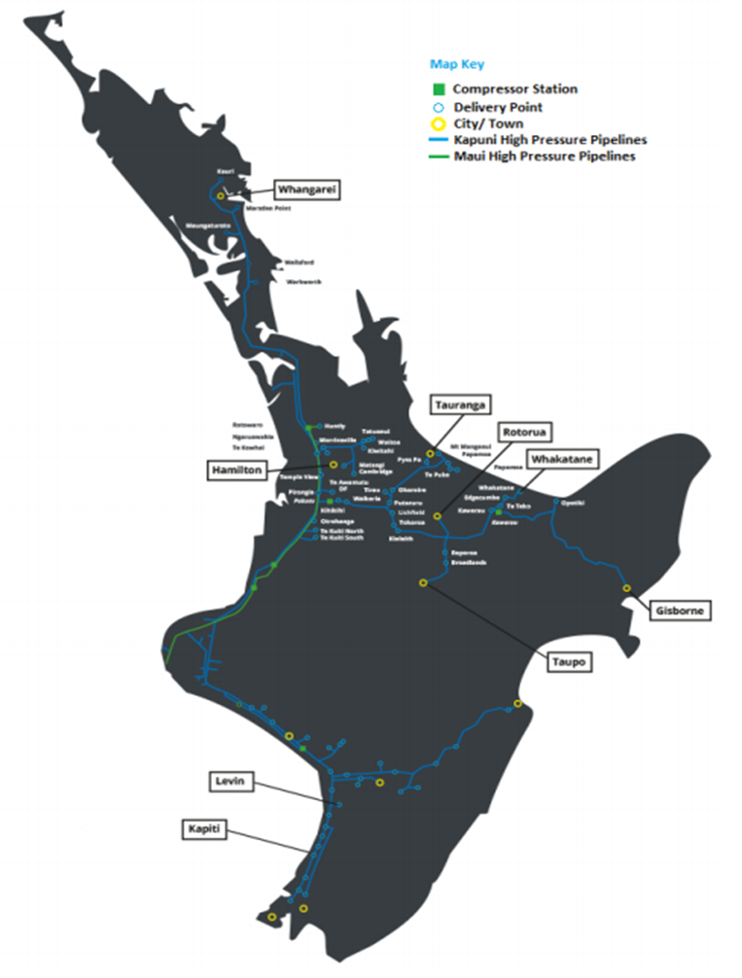
Transmission pipeline thresholds
Pipeline | Point of Measurement | Pmin (barg) | Time to Pmin (hours)
Maui | Rotowaro | 30 | 3
Frankley Road | KGTP | 35 | 3
South | Waitangirua | 33 | 10
Hawkes Bay | Hastings | 30 | 5
Bay of Plenty | Gisborne | 30 | 5
Bay of Plenty | Tauranga | 30 | 5
Bay of Plenty | Whakatane | 30 | 5
Morrinsville Lateral | Cambridge | 27.5 | 5
Central (North) | Westfield | 37.5 | 6
North | Whangarei | 27.5 | 5
 | Any Other Gas Gate | 30 | 5

Slide 11
History of CC Events:
1st test exercise: Feb 2010 Maui pipeline outage due to landslip
1st event: July 2010 Pohokura outage. No curtailment
2nd event: Oct 2011 Maui pipeline outage due to landslip
Curtailment to band six for 5 days
3rd event Mar 2012 Pohokura outage
Curtailed 50% band 1 for 8 hours
4th event May 2016 Production outages. No curtailment (1st event under amended Regs)
5th event May 2017 System imbalance. No curtailment.
6th event Sept 2024 Pipeline blockage at Mt. Maunganui
No curtailment
Potential Critical Contingencies: 11
Annual Exercises: 16

Slide 12
How are Critical Contingencies resolved?

Slide 13
The system must be protected while the supply problem is fixed through:
Curtailment of consumers.
and/or
Supply of more gas if it is available and will help the situation.

Slide 14
Consumer Curtailment Bands
Band | Consumption | Description
0 | Any | Gas Storage
1 | >15 TJ/day | Consumers with alternative fuel capability supplied directly from the transmission system
2 | >15 TJ/day | Consumers without an alternative fuel capability supplied directly from the transmission system
3 | >10 TJ/annum up to 15 TJ/day | Large industrial and commercial consumers
4 | >250 GJ/annum up to 10 TJ/annum | Medium industrial and commercial consumers
5 | >2 TJ/annum | Essential services designated consumers
6 | <250 GJ/annum | Small commercial consumers
7 | Any | Critical care designated consumers

Slide 15
Designations
Consumers can apply for designations from the Gas Industry Company
Designation Types | Description
Essential Services (Band 5) | Mortuary services, crematoriums, heat treatment of biohazards, municipal water supply, treatment of municipal sewage, emergency services >2 TJ per year
Critical Care (Band 7) | Hospitals, primary health care, prisons, essential support for critical care providers
Critical Processing | To avoid serious damage to plant, mitigate serious environmental damage, or prevent inhumane treatment of animals at an abattoir
Electricity Supply | To start up or switch to generation plant that runs on fuel other than natural gas; or to synchronise a unit that provides voltage support.

Slide 16
Who is required to act?

Slide 17
Key participants
Transmission System Operator
Critical Contingency Operator
Retailers
Large Consumers
Producers

Slide 18
What are they required to do?

Slide 19
Transmission System Operator
(TSO – Firstgas Ltd)
Operate the system using a suite of contracts and operating codes
Identify there is a potential issue
Notify Critical Contingency Operator
Continue to operate system
Implement and communicate decisions made by the CCO. Communicate about failed asset
Notes:
Add remediate pipeline issues.

Slide 20


Critical Contingency Operator (CCO)
- Appointed by GIC
- Plant & Platform Ltd
- 3 Approved Persons
Determine a Critical Contingency exists
Decide who must curtail gas use
Notify TSO and industry of decisions
Keep the industry informed
Determine that a Critical Contingency has finished
Explore opportunities for additional gas

Slide 21
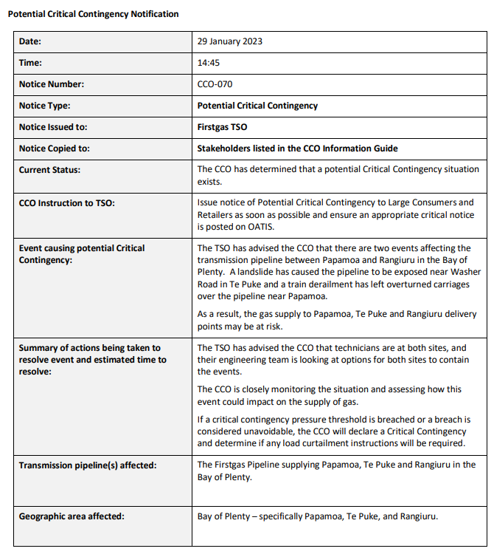
Example CCO notice
Sent to Firstgas
Copied to Stakeholders in CCO Contacts List
Posted on CCO Website
SMS Alert Optional

Slide 22
Retailers
See notifications that there is a Critical Contingency
Receive instruction from Firstgas about who must curtail gas use
Urgently contact affected customers to instruct them to curtail
Update Firstgas on curtailment progress
Send out a media appeal for users to reduce gas use, if requested by CCO

Slide 23
Producers
See notifications that there is a Critical Contingency
Consider whether extra gas can be made available to assist
If producer’s asset has contributed to Critical Contingency, communicate with Firstgas, the CCO and the wider industry about the issue

Slide 24
Large Consumers
See notifications that a Critical Contingency exists
1
Receive notifications from Firstgas about curtailment
2
Follow the curtailment instructions if affected
3
Update Firstgas on curtailment progress
4

Slide 25
Non-Domestic Consumers
Receive notifications about curtailment from retailer
1
Follow the curtailment instructions if affected
2
Update their retailer on curtailment progress
3

Slide 26
How does the industry prepare?

Slide 27
What needs to be in place:
Critical Contingency Management Plan
Communications protocols (Information Guide and Communications Plan)
Retailer Curtailment Plans
Consumers allocated to correct bands
Supply designations
Up to date contact details
Annual industry training
Annual industry exercise

Slide 28

Annual Exercise:
Reg 34: “to test:
The Firstgas Critical Contingency Management Plan (CCMP) complies with regulation 25 “; and
that the Retailers’ list of emergency contact details required by regulation 43 is current.”
Refer to the Participants Brief available on CCO website (Publications).
Wednesday 13 May 2026 – Exercise Aituā

Slide 29
Where do you get more information?

Slide 30
Websites
CCO www.cco.org.nz
Current Events
Historic Events – Examples of Notices
Publications
Training Information
TSO www.oatis.co.nz
Notices
Retailer & Large Consumer Template
Publications
Quick Reference Guides

